Slide 1
INTERNAL
Paradise Sea Tours
On-demand boat rides across Nassau, and the four things that run it.

Slide 2
The business
A passenger asks for a boat. We find one, agree the price up front, and the captain runs the trip. Fixed fares, no haggling on the dock.
WHO IT'S FOR
HOW IT WORKS
HOW IT EARNS
WHERE IT RUNS
Cruise passengers with a few hours ashore, and locals crossing to Paradise Island, the beaches and the cays.
Book online. We ask a captain. Nothing is promised until a boat has said yes. Then the trip is confirmed and run.
A fixed fare per passenger by route. Boats are paid every Friday for the trips they ran that week.
Nassau: the cruise port, Paradise Island, Atlantis, Cabbage Beach, Rose Island and the cays. 7am to 10pm.
Founded by Shavane Turnquest (Nassau operations, boats) and Jack Lowe (platform).

Slide 3
Four parts
One for each person in the trip, and one for the office.
1 WEBSITE
2 PASSENGER APP
3 CAPTAIN APP
4 ADMIN
Where a passenger finds us and books. Public, and the only part a stranger ever sees.
The same booking on a phone, plus their own trip page and a way to message the boat.
A boat's day: whether he's available, the run he's been offered, and what he's owed.
The office board. Every booking, every client, every boat, and Friday's payout.

Slide 4
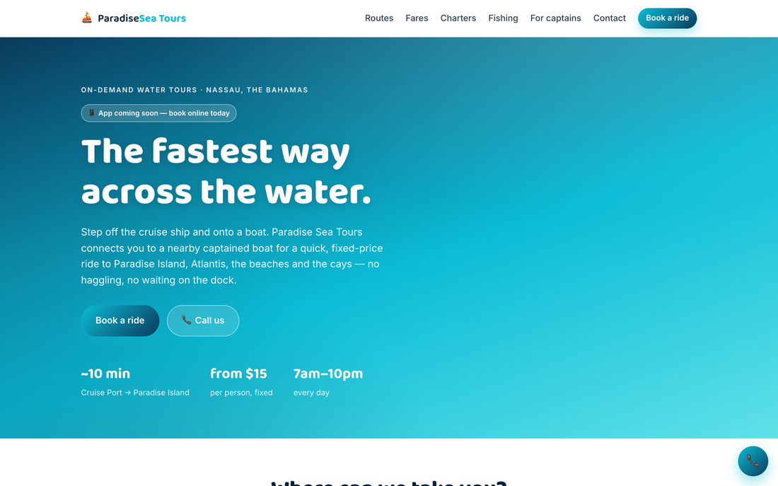
1 — WEBSITE
Where people find us
Public, and the only part a stranger ever sees. It says what the trip is, what it costs, and how long it takes — before anyone has to ask.
The fare is stated up front. No haggling on the dock is the pitch, so the price is on the first screen.

Slide 5
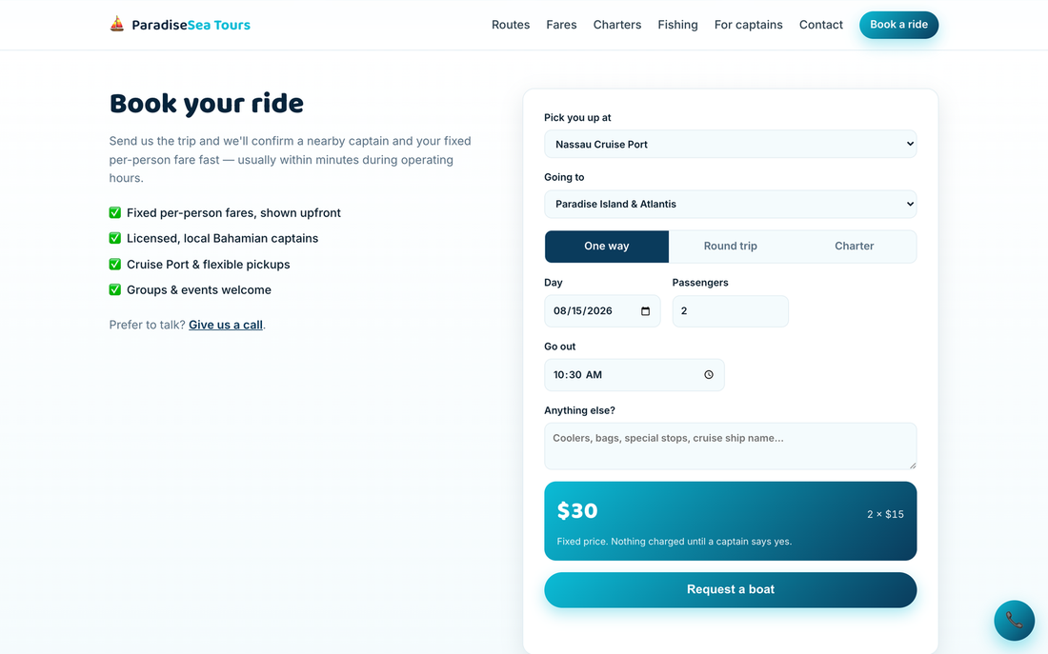
1 — WEBSITE
Booking, step one
Pick up, drop off, one way or return, the day, how many people. Every dock is a real Nassau meeting point rather than a free-text box.
Nothing here asks who they are yet. That comes after they've seen a price.

Slide 6
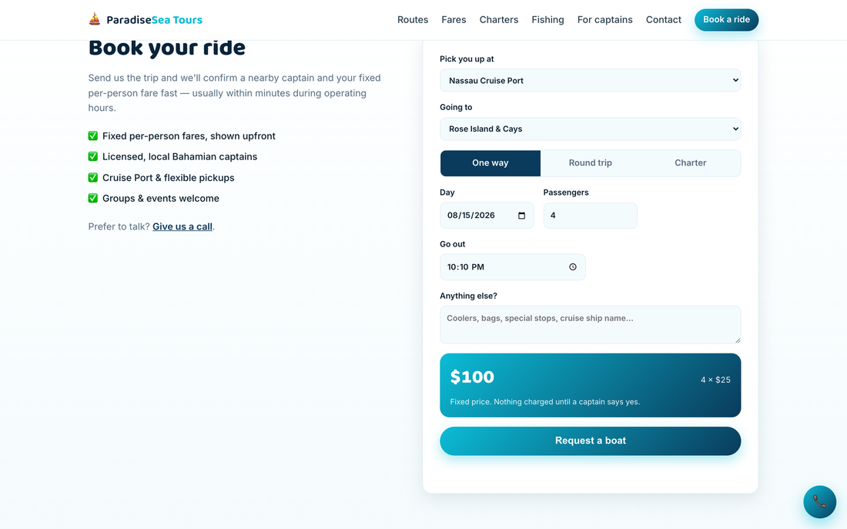
1 — WEBSITE
The price, before they commit
The fare is worked out live from the published price list as they change the trip, so there is never a surprise later.
"Nothing charged until a captain says yes" is the promise the whole system is built to keep.

Slide 7
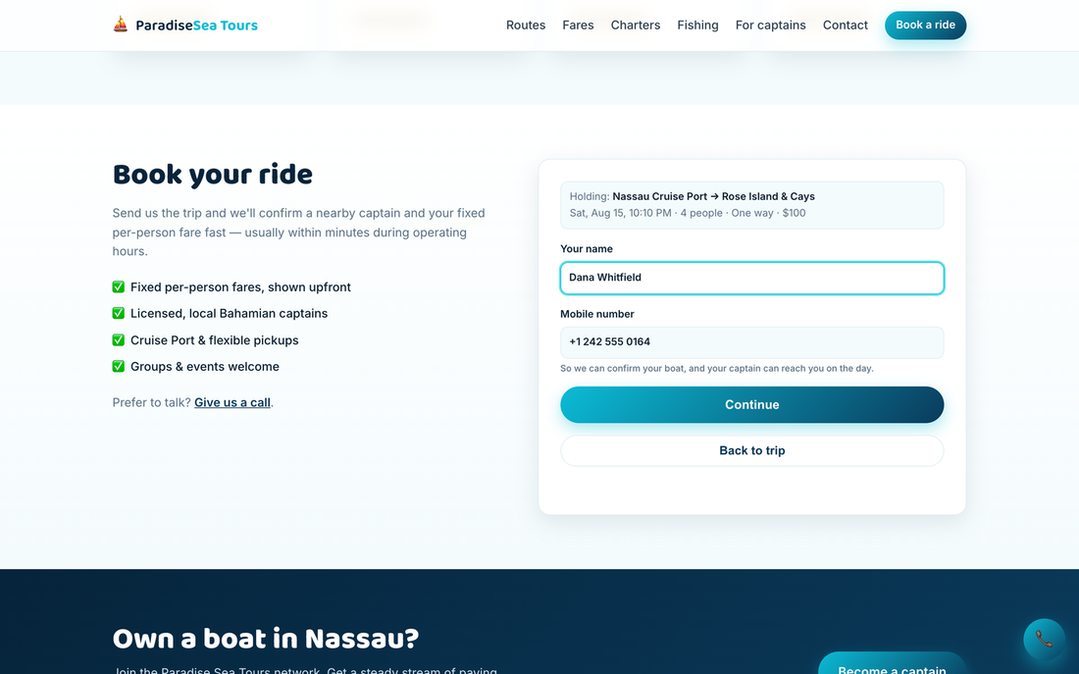
1 — WEBSITE
Who we're holding it for
Only after the trip is chosen do we ask for a name and number. The trip is shown held above the form so nothing feels lost.
Phone numbers are tidied automatically — someone typing 2425550164 gets +1 242 555 0164 without being told off.

Slide 8
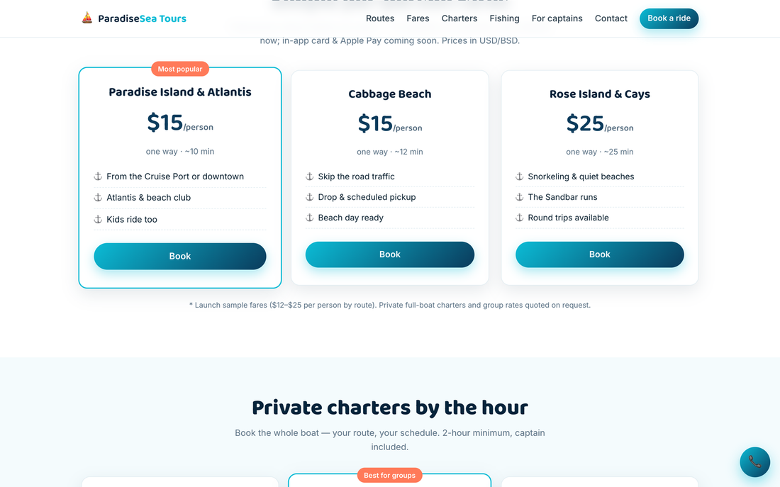
1 — WEBSITE
Routes and fares
Fixed prices by route, published. Charters and fishing trips are listed alongside the crossings.
These are the same prices the booking form and the office board both read from — one list, three places.

Slide 9
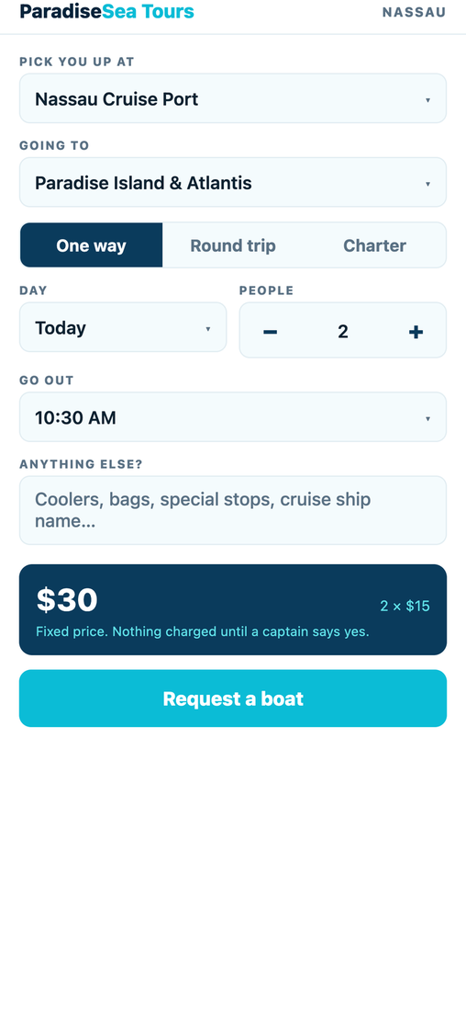
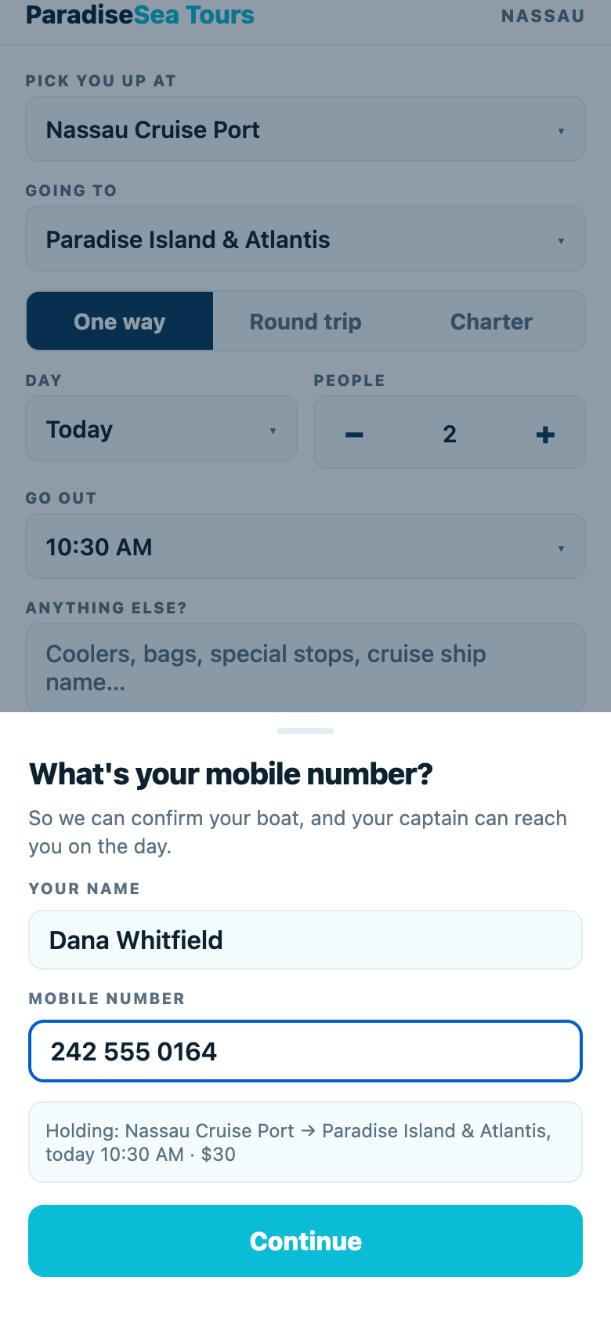
2 — PASSENGER APP
Booking from a phone
The same booking as the website, built for a thumb. Fares update as the trip changes.
Pick the trip. The price is on the same screen, not a step later.
Only then does it ask who they are — with the trip held above the form, so nothing feels lost.

Slide 10
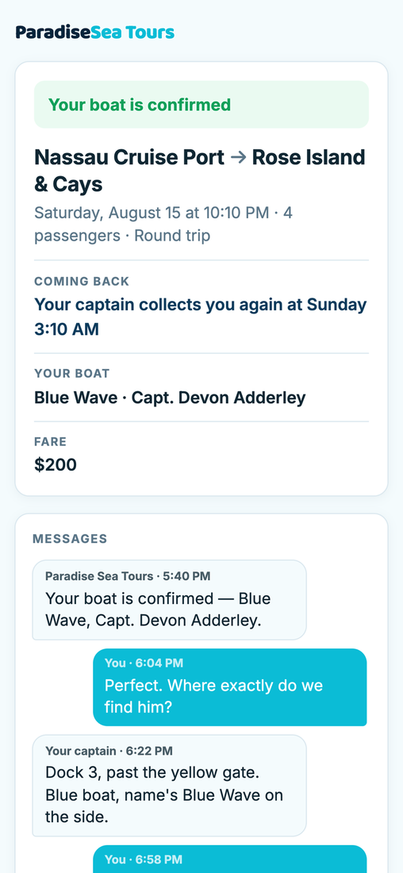
2 — PASSENGER APP
Their own trip page
Once booked, a passenger gets a private page: their boat, their captain, the fare, and a message thread with both the boat and the office.
No account needed to open it — the link is the key. And no phone numbers change hands in either direction.

Slide 11
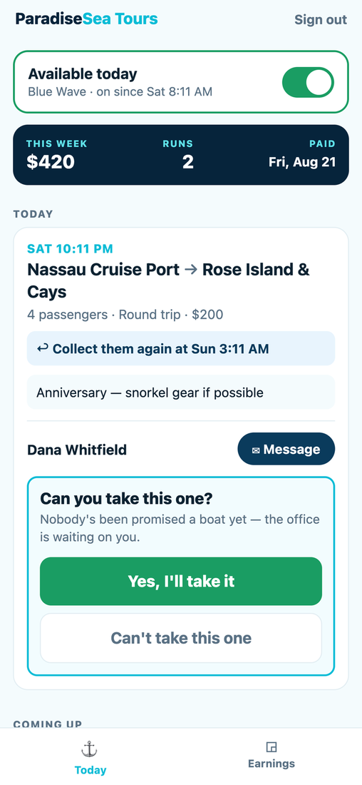
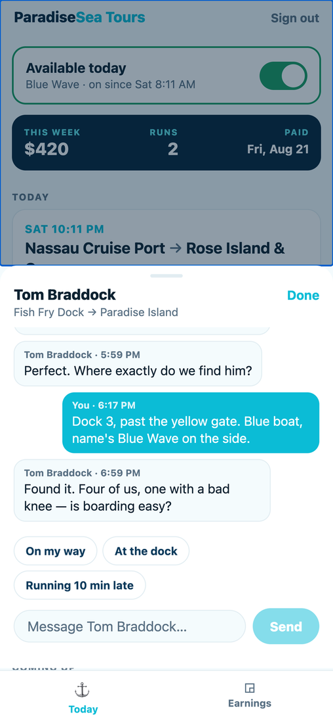
3 — CAPTAIN APP
A boat's day
Built for one hand on a moving boat: big targets, one action at a time, nothing to hunt for.
Available today, what he's earned this week, and the run he's been offered — yes or no.
The passenger thread, with one-tap replies for the things he says most.

Slide 12
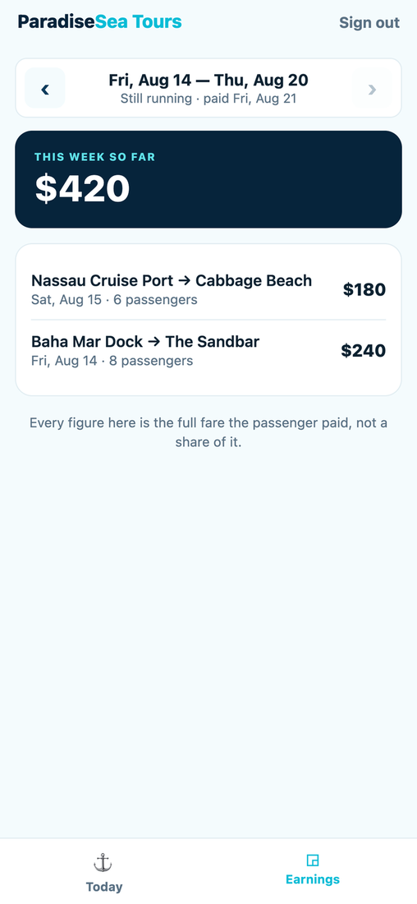
3 — CAPTAIN APP
What he's owed
Run by run, week by week. The same completed trips the office adds up on Friday, shown to the person being paid.
A captain querying a number is pointing at the same figure the office is looking at, which is the point.

Slide 13
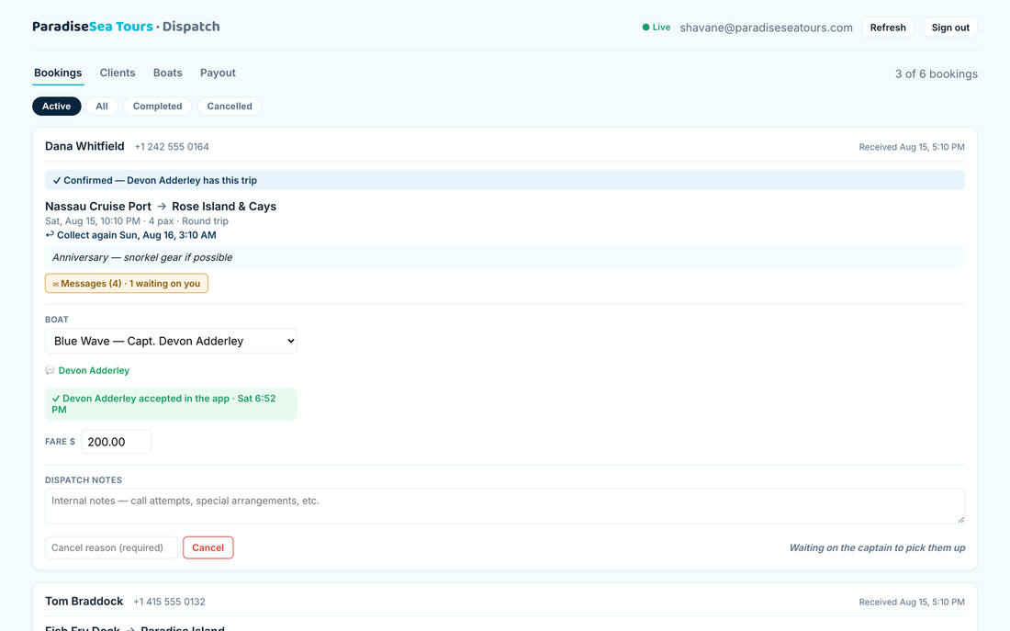
4 — ADMIN
The board
Every booking in one place: who, where, when, which boat, what fare. This is where the day is actually run from.
A new booking arrives here and on Telegram at the same moment, with the fare already worked out.

Slide 14
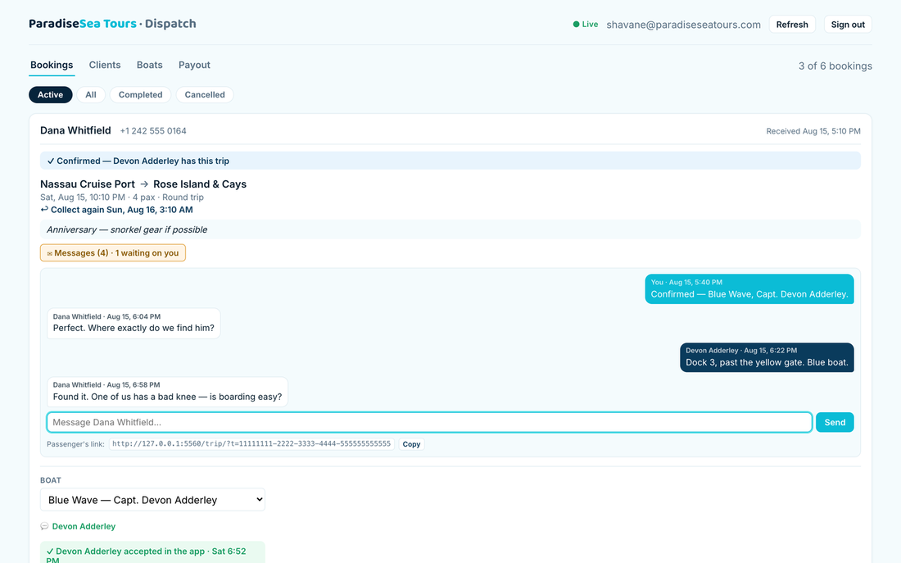
4 — ADMIN
Talking to a passenger
One thread per trip, shared by the passenger, their captain and the office — which replaced WhatsApp entirely.
Amber means somebody asked a question nobody has answered yet.

Slide 15
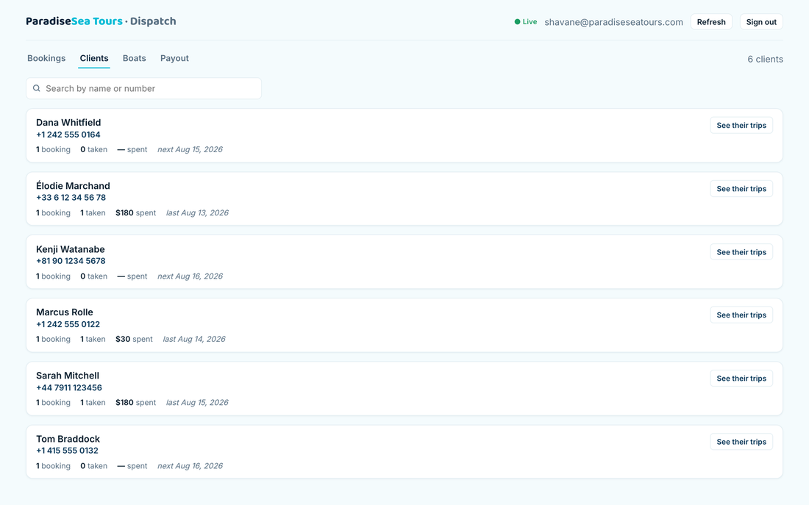
4 — ADMIN
Clients
Everyone who has ever booked, grouped by phone number, with what they've spent and when they're next out.
Someone who books three times is one client, however differently they spelled their name each time.

Slide 16
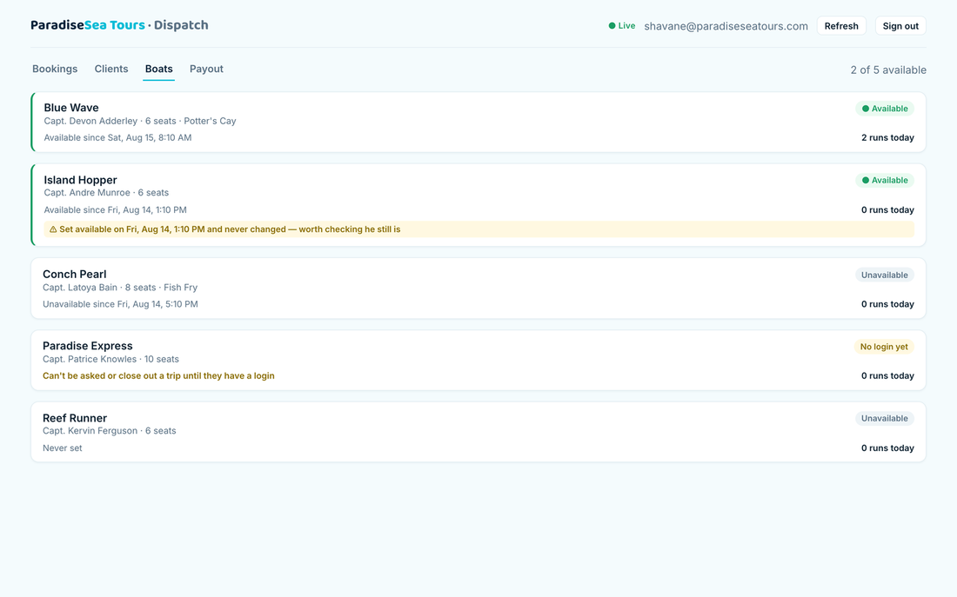
4 — ADMIN
Boats
Who is available today and since when, how many runs each has on, and which captains still have no login.
A captain who switched himself on yesterday and never off gets flagged, rather than quietly believed.

Slide 17
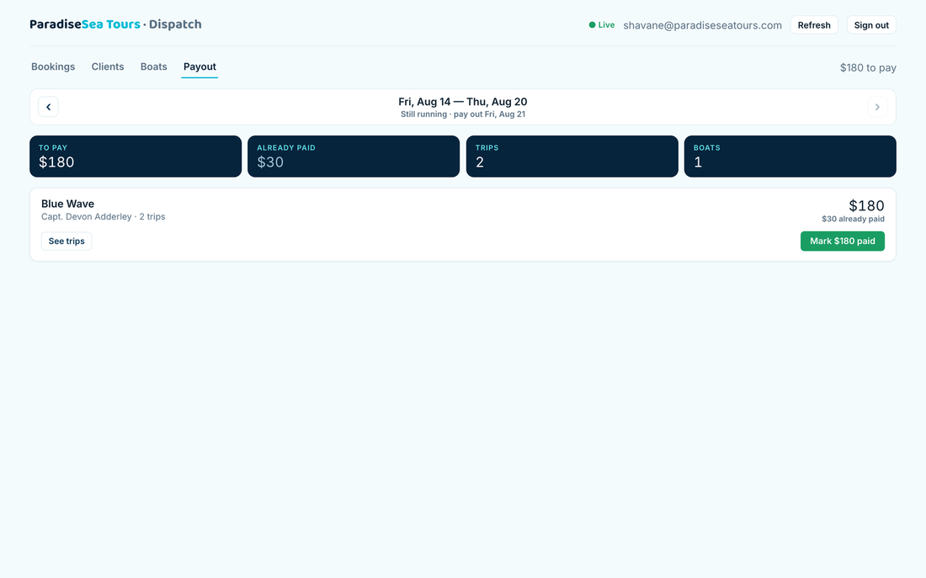
4 — ADMIN
Friday payout
What each boat is owed for the week, with the trips behind the number and a record of what's been paid.
The pay week runs Friday to Thursday and settles the Friday after. Only completed trips count.

